Slide 1

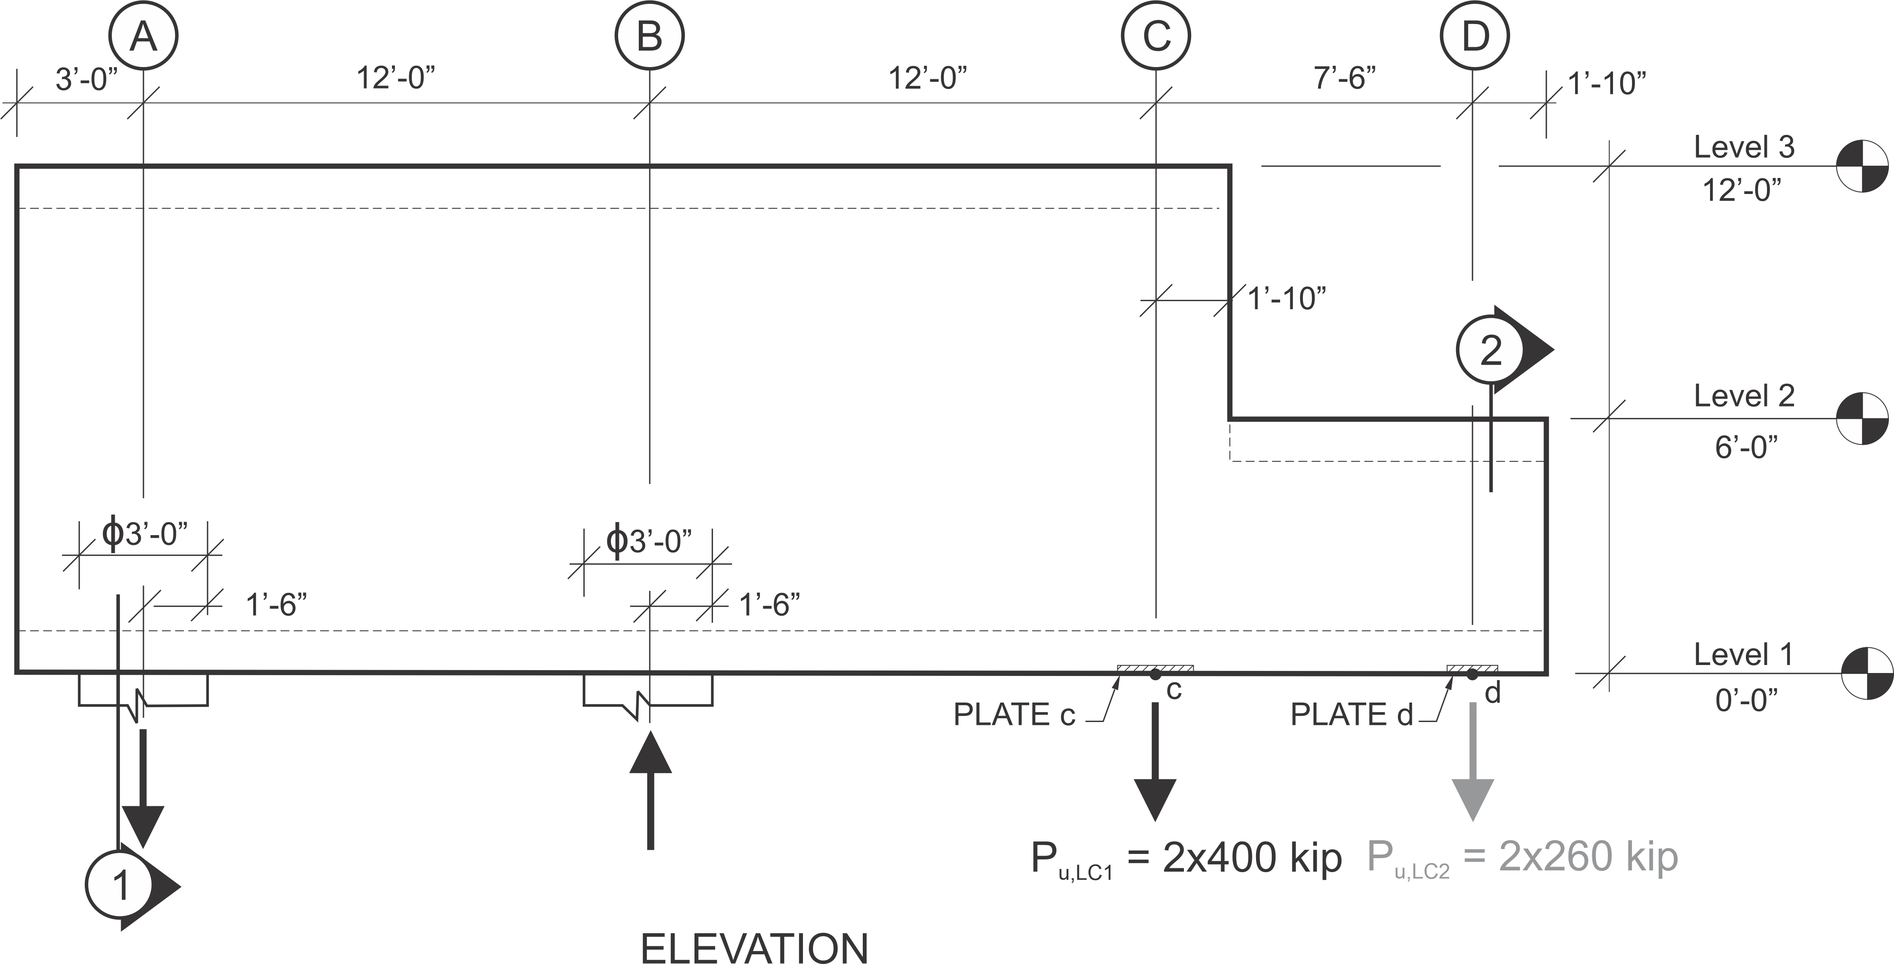
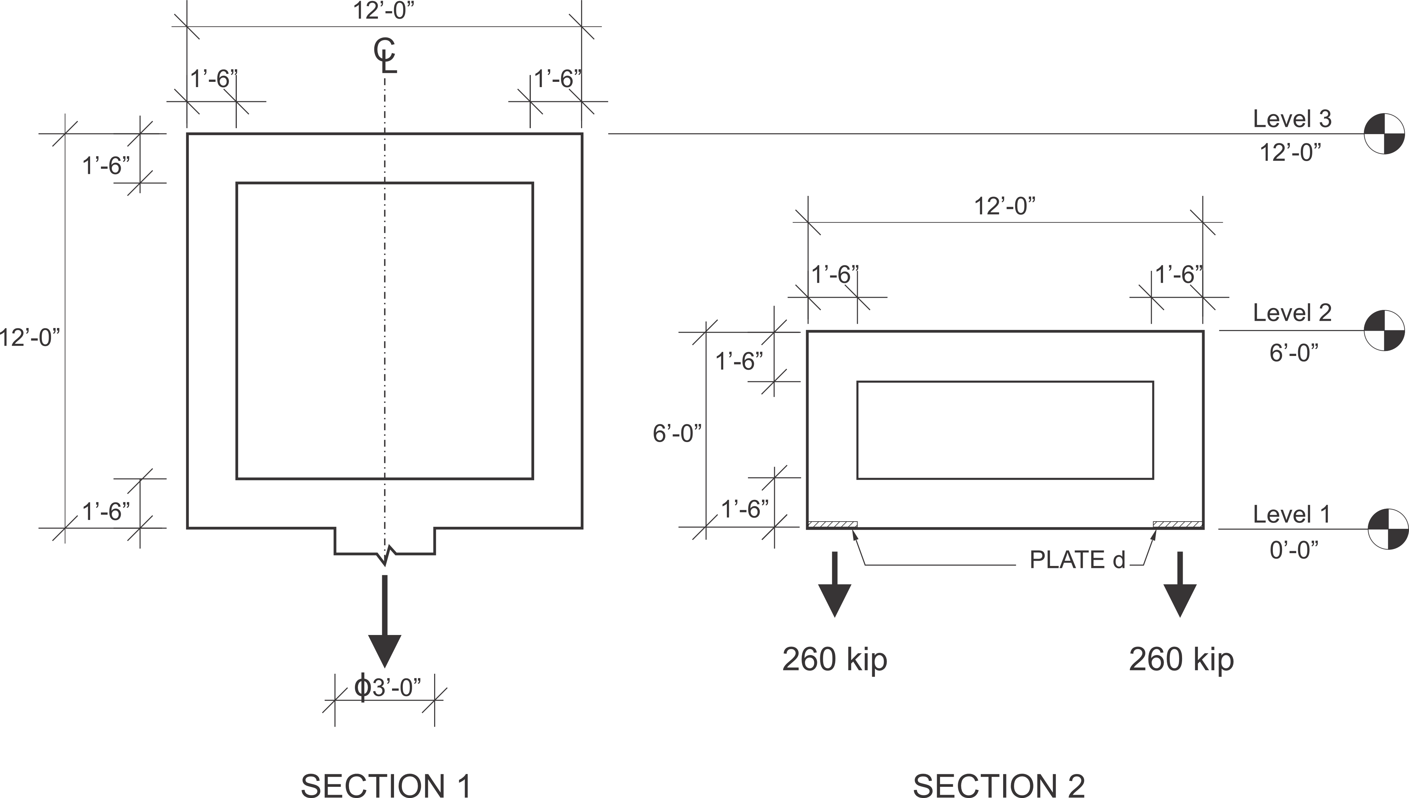
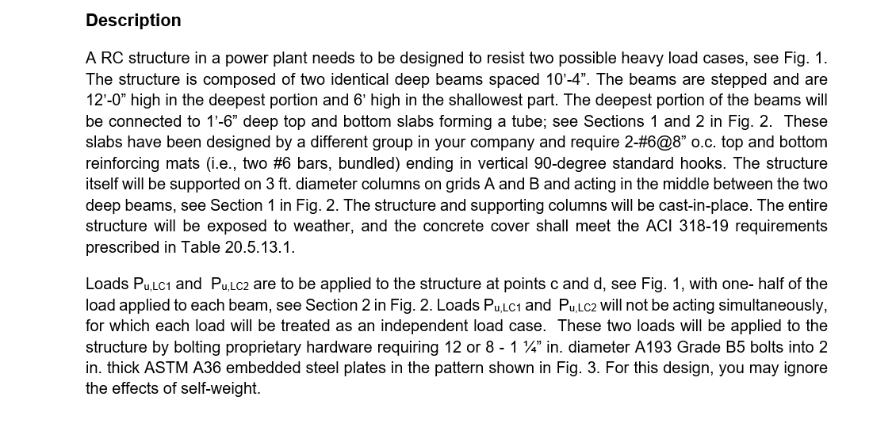
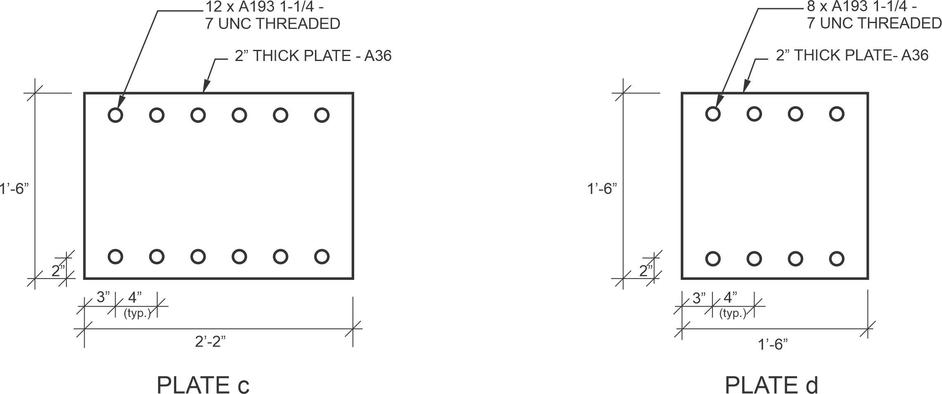
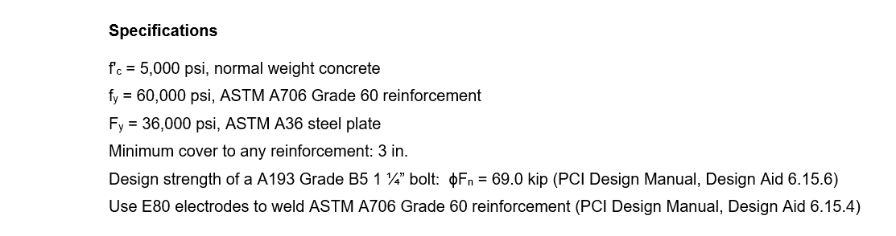

Slide 2
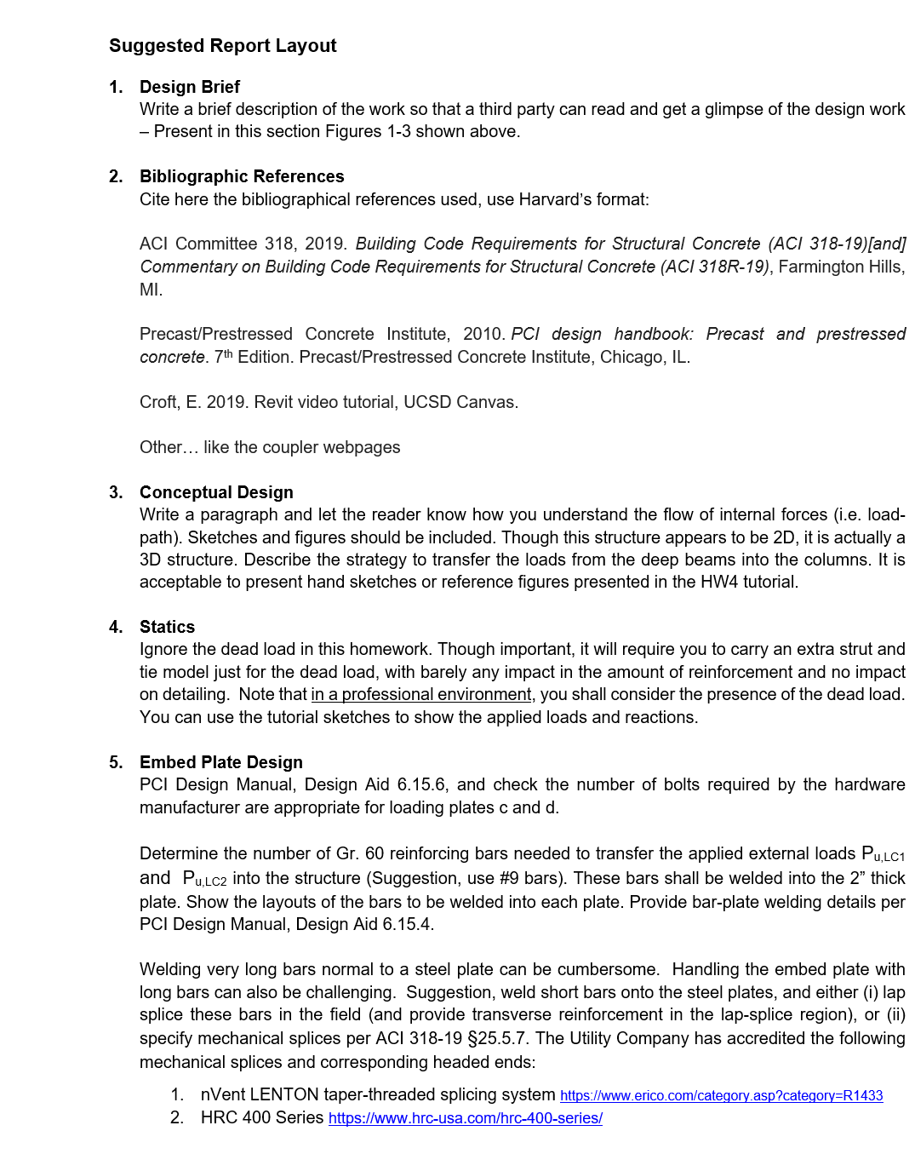
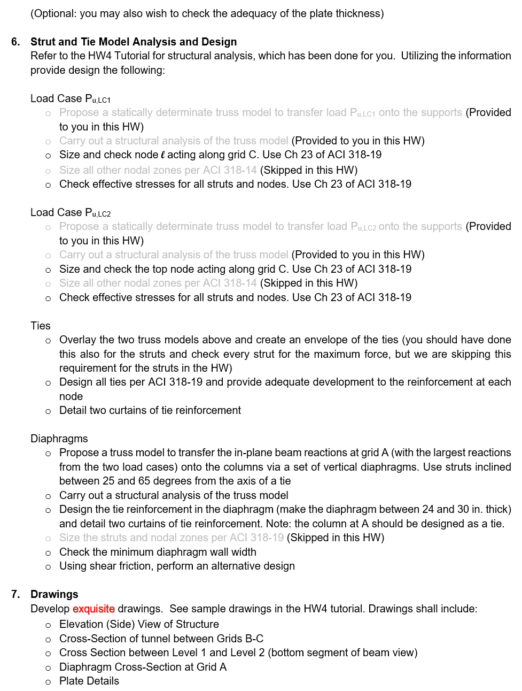
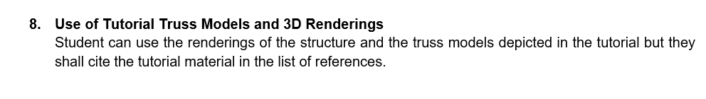

Slide 3
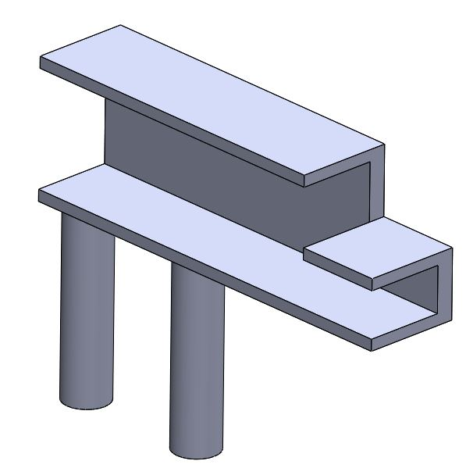
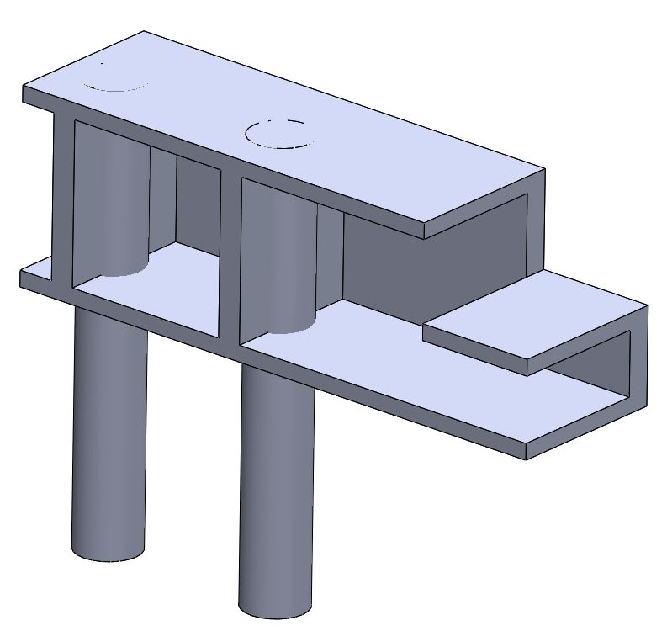

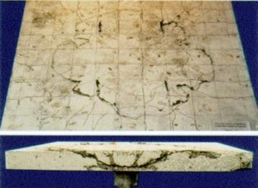
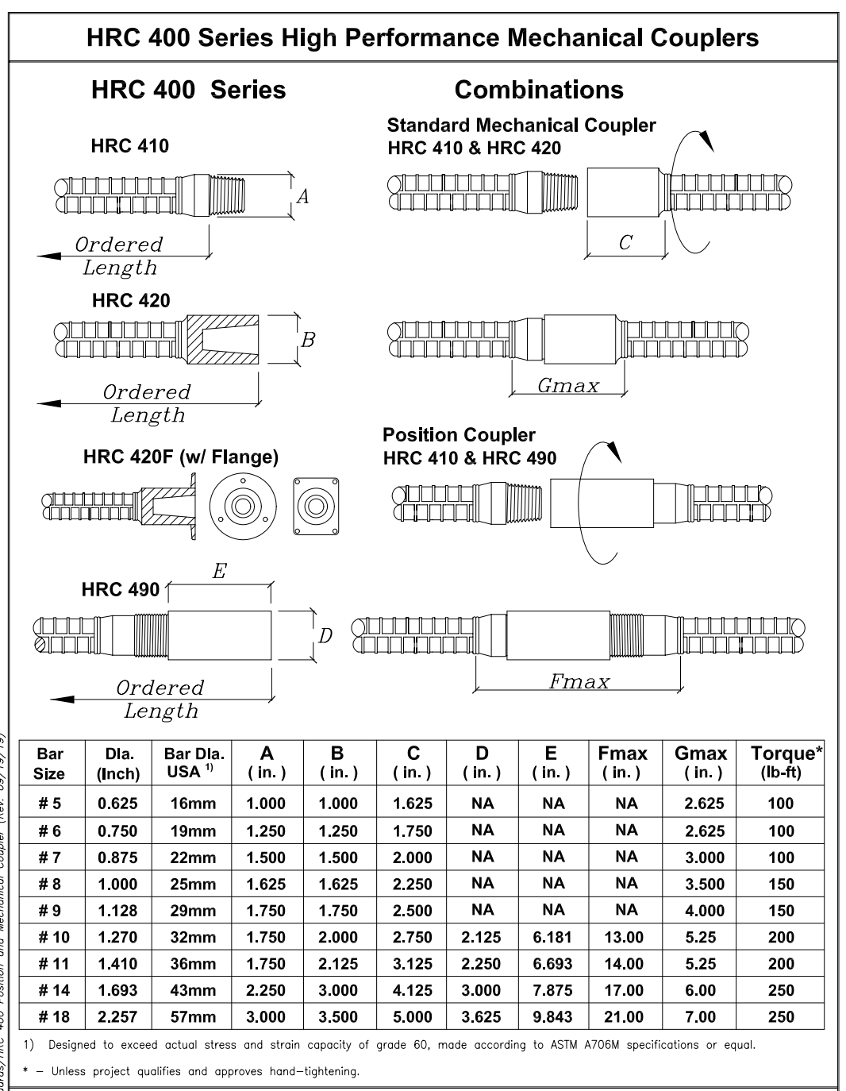
Conceptual Design
https://www.sheffield.ac.uk/polopoly_fs/1.107474!/image/punching_shear.jpg
http://www2.hrc-usa.com/downloads/products/HRC400/HRC400-SPEC.pdf

Slide 4
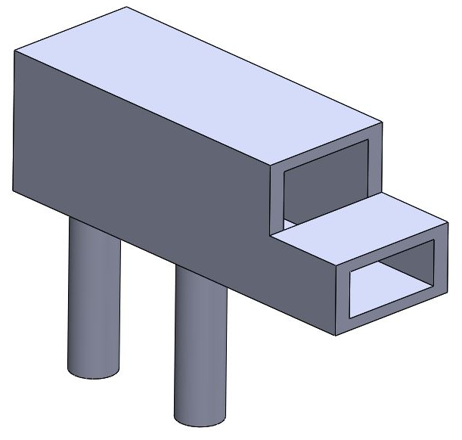
Load Cases and Reactions

Slide 5
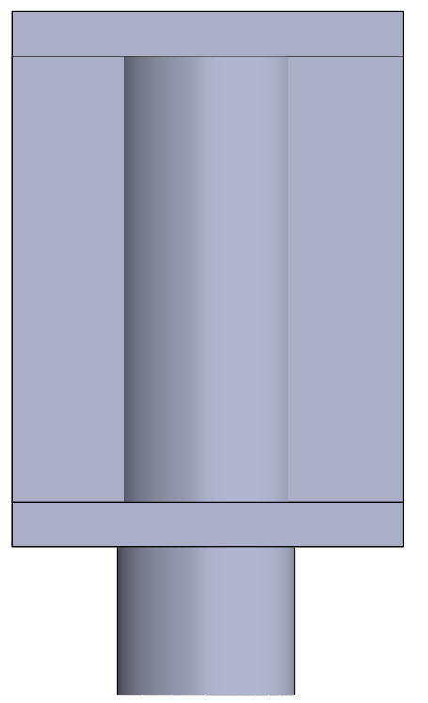
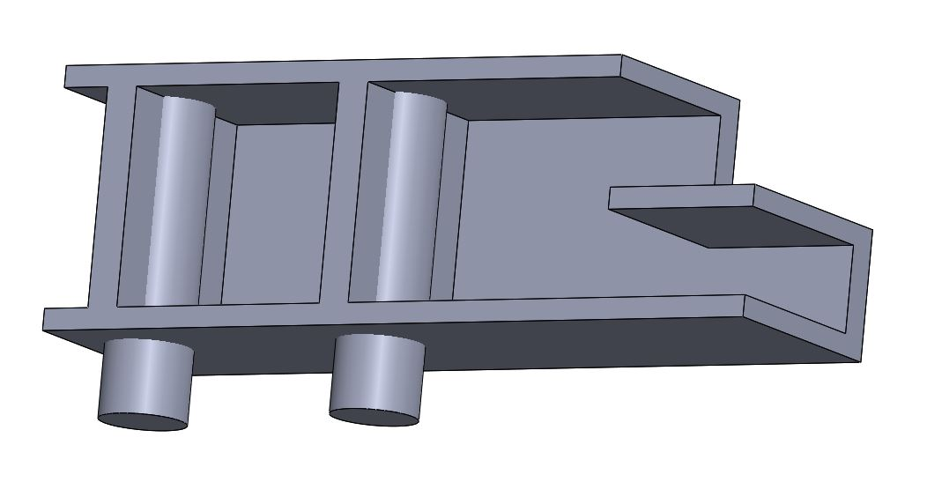

Shear Flow at the Diaphragm Wall Interface
Wall midplane
Wall midplane
At wall midplane
At wall midplane

Slide 6
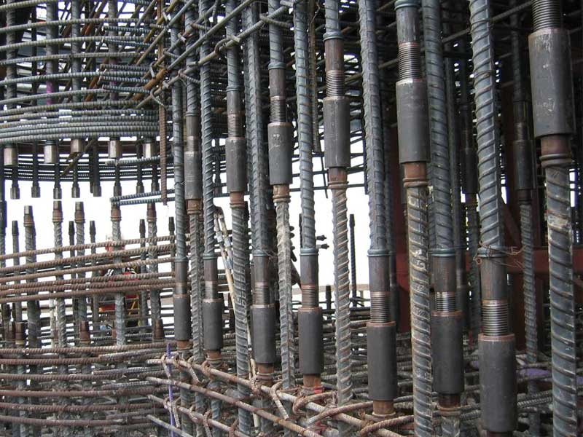
Embed Plate Design
http://www2.hrc-usa.com/downloads/products/HRC400/HRC400-SPEC.pdf
30”
20”
https://texumrebarcoupler.com/wp-content/uploads/2020/04/rebar-coupler-blog.jpg

Slide 7
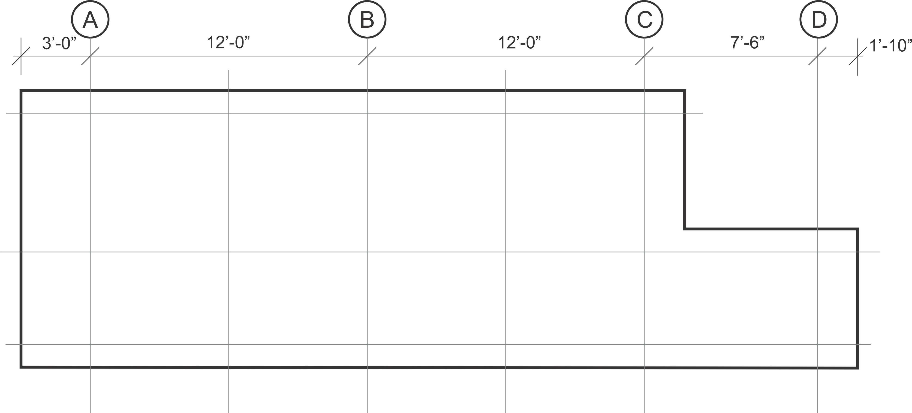
Truss Models – Load Case 1
The challenge is to find an internal force flow (load path) using a statically determinate truss that satisfies all boundary conditions:
-truss elements within physical envelope but not at the envelope
-explain the collector
480
400
400

Slide 8
Truss Models – Load Case 1
480
5 : 6
480
480
5 : 6
400
800
400
400
400
Explain
400
Strain energy index
SEI= 480x24 = 11,520

Slide 9
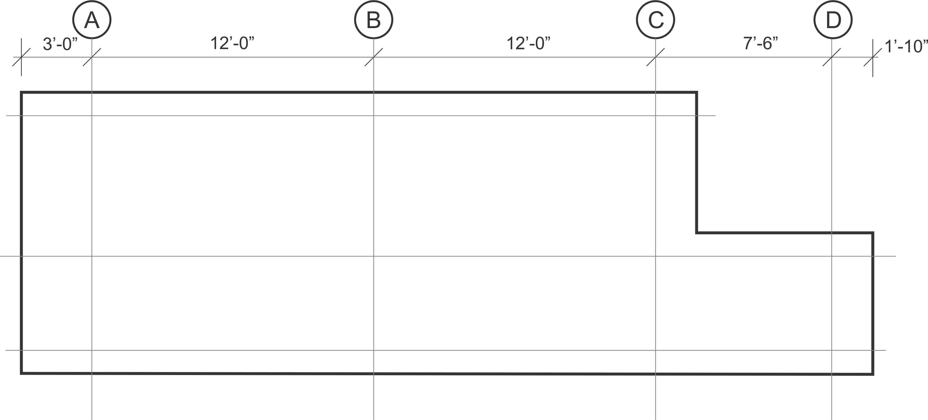
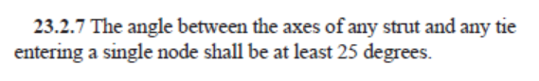
Truss Models – Load Case 2
682.5
1267.5
487.5
422.5
1267.5
422.5
780
487.5
260
260
260
V : H
18.4º
260
18.4º
1 : 3
1 : 3
8 : 15
28.1º
487.5
260
SEI= 1267.5x24 + 487.5x7.5 + 260x4 + 260x5 = 36,416

Slide 10
Truss Models – Load Case 2
682.5
633.5
1267.5
877.5
487.5
422.5
633.5
633.5
390
390
487.5
422.5
422.5
422.5
260
260
260
260
260
33.6º
33.6º
33.6º
260
33.6º
2 : 3
2 : 3
2 : 3
2 : 3
8 : 15
28.1º
633.5
877.5
487.5
260
Strain energy index
SEI= 633.5x6 + 1267.5x12 + 877.5x6 + 487.5x7.5 + 422.5x4 + 260x4x2 + 260x5 = 33,002

Slide 11
Truss Models – Load Case 2
312
260
5 : 6
312
312
5 : 6
260
682.5
260
39.8º
260
243.75
487.5
243.75
2 : 3
487.5
162.5
162.5
162.5
260
162.5
260
2 : 3
243.75
8 : 15
243.75
487.5
260
Strain energy index
SEI= 312x24 + 243.75x6+ 487.5x25.5 + 162.5x4 + 260x10 + 260x5 = 25,932

Slide 12
Truss Models – Load Case 2
260
1 : 1
260
260
1 : 1
260
260
682.5
260
45º
260
243.75
617.5
487.5
162.5
243.75
2 : 3
2 : 3
487.5
162.5
162.5
422.5
260
260
260
2 : 3
633.75
390
8 : 15
243.75
487.5
260
Strain energy index
SEI= 260x24 + 243.75x6 + 617.5x12 + 487.5x13.5 + 162.5x4 + 260x10 + 260x5 = 26,244

Slide 13
Truss Models – Revisiting the Truss Model for Load Case 1
400
1 : 1
400
400
1 : 1
400
800
400
400
200
2 : 3
2 : 3
400
400
400
600
600
400
Strain energy index
SEI= 400x24 + 600x12 = 16,800

Slide 14
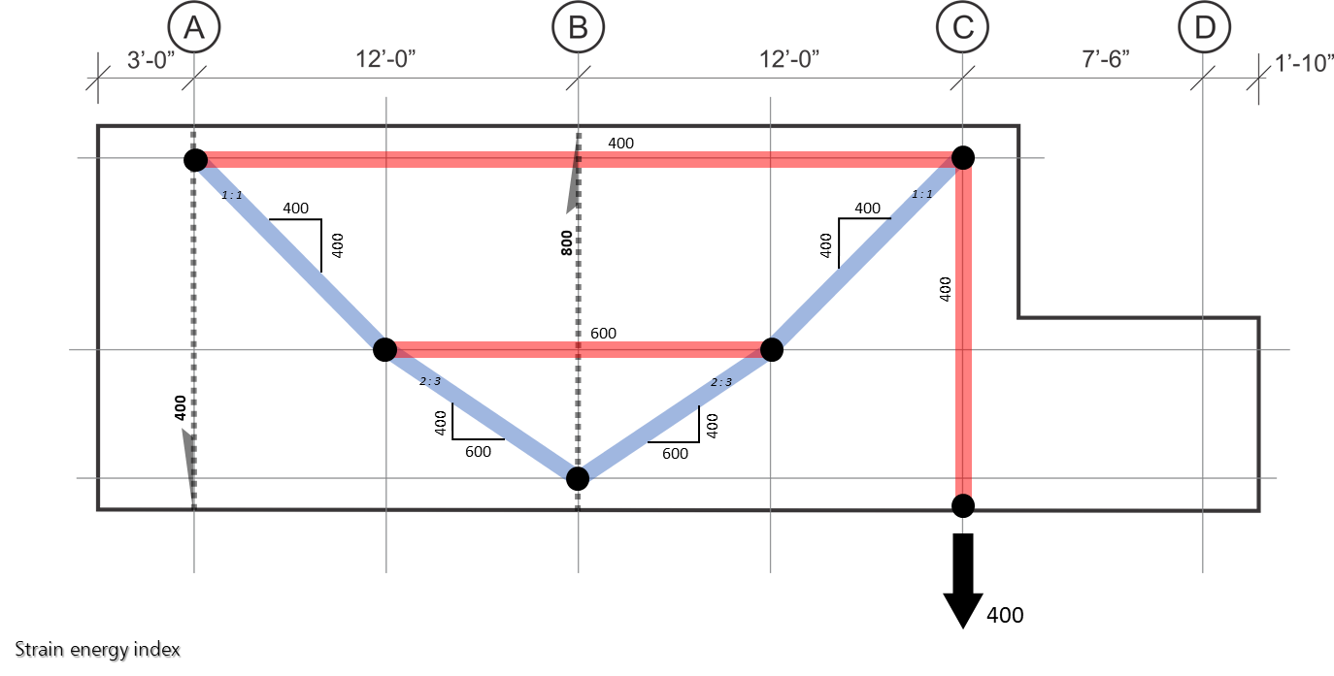
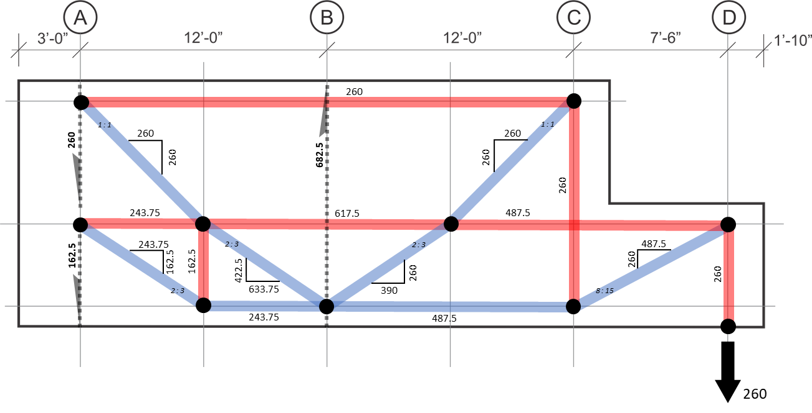
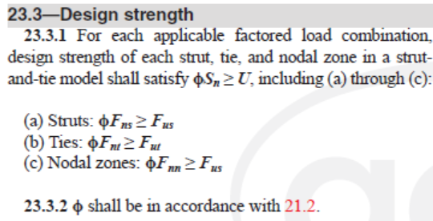
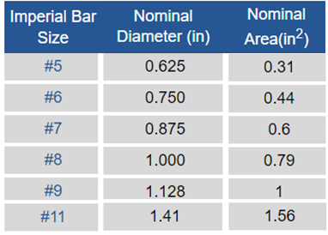

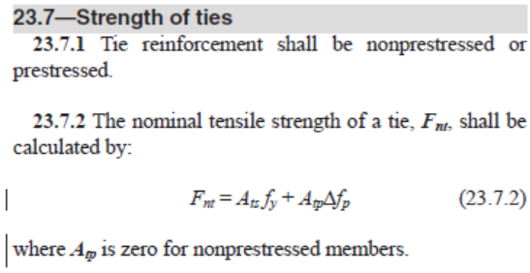
Tie Design
k
l
k
l
j
j
l
g
h
f
g
h
i
a b
a b c
d
c
e
Member | T_{u LC1} (kip) | T_{u LC2} (kip) | (kip) | A_{s,required} (in²) | Bar Array | A_{s,provided} (in²)
…
id - 260 260 5.78 6#9 6.00
ih - 487.5 487.5 10.83 8#11 12.48
https://www.harrissupplysolutions.com/steel-rebar-sizes-stock.html

Slide 15
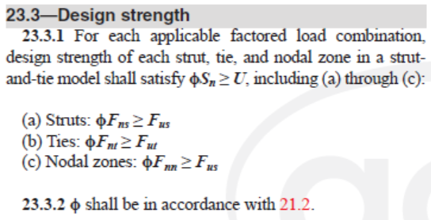
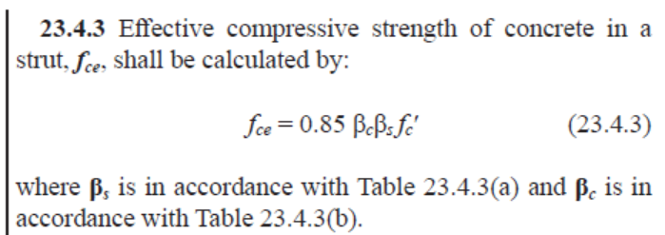
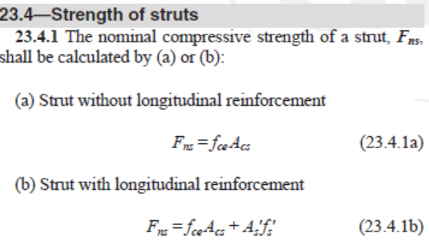
Strut Design
k
l
k
l
j
j
g
h
f
g
h
i
552.5
a b
a b c
d
c
e

Slide 16
Nodal Zone Design
k
l
k
l
j
j
g
h
f
g
h
i
552.5
a b
a b c
d
c
e
Table 23.4.3(a)—Strut coefficient β_{s}
Member | C_{u LC1} (kip) | C_{u LC2} (kip) | (kip) | Strut type Table 23.4.3(a) | β_{s} | Strut type Table 23.4.3(b) | β_{c} | f_{ce} (psi) | Strut’s min. width, w_{min} (in.)
…
…
Table 23.4.3(b)—Strut and node confinement modification factor β_{c}
ci - 552.5 552.5 (c) 0.75 (c) 1.0 3,188 12.8

Slide 17
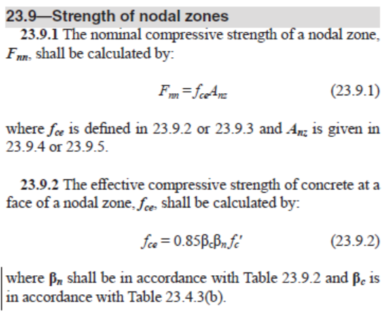
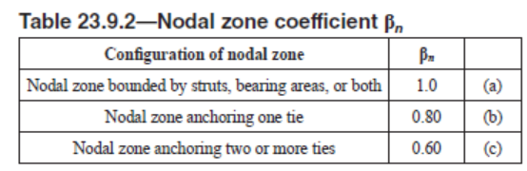
Nodal Zone Design
k
l
k
l
j
j
g
h
f
g
h
i
552.5
a b
a b c
d
c
e
Node | Node type Table 23.4.3(b) | β_{c} | Node type Table 23.9.2 | β_{n} | f_{ce} (psi)
…
Table 23.4.3(b)—Strut and node confinement modification factor β_{c}
…
i (c) 1.0 (c) 0.6 2,550

Slide 18
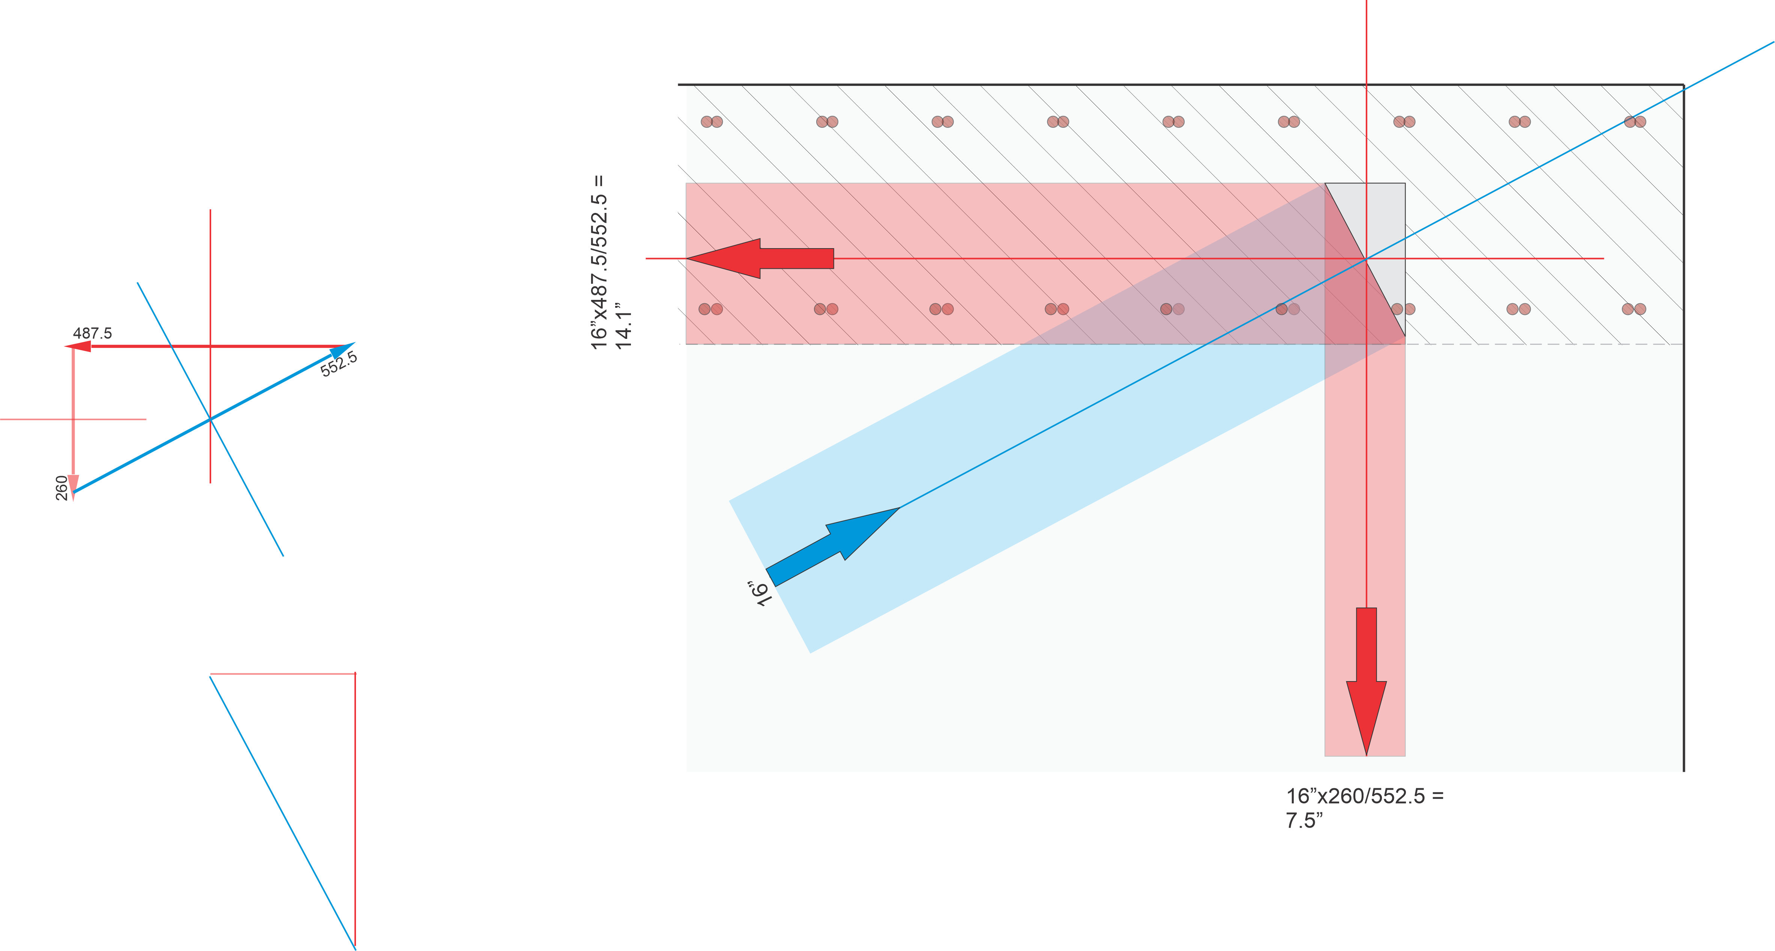

Design & Detailing of Nodal Zone i – Step 1: Sizing – Trial 1
Strategy,
Force polygon and
joint construction
h
i
d
-Trial fails, we can’t have the 6#9 bars within a 7.5” wide tie id
if we place 3 on each face.
-The extreme #9 bar array are spaced 8” o.c., hence, a 10-12” tie width is deemed suitable. Do a second try starting with a 12” wide tie.

Slide 19
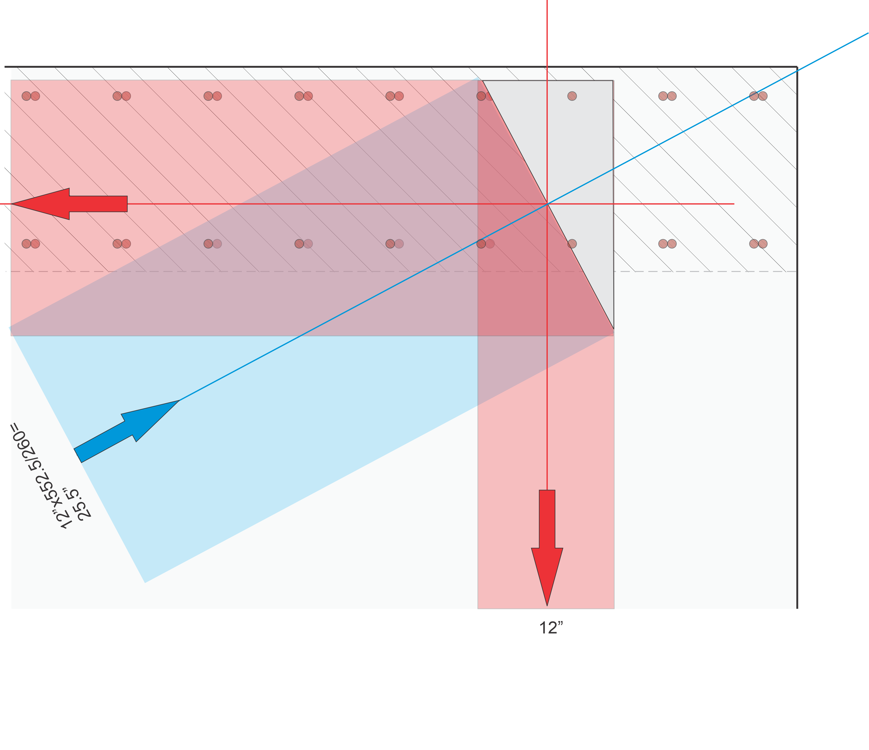
Design & Detailing of Nodal Zone i – Step 1: Sizing – Trial 2
Tie id max. width
(Engineering judgement)
h
i
Top view of 3#9 (on one face)
2 to 3”
2 to 3”
8”
d
-By choosing 12” for the vertical strut di, we increased the size of the joint and of all other ties and struts. The joint and strut stresses decreased as a result
-We need to examine every other tie and ensure the width is appropriate to accommodate the tie’s reinforcement. Further trials may be needed in some cases. Here, the horizontal tie ih is 18.75” wide and can easily accommodate the 8#11 bars placed in four layers of 2#11

Slide 20
Design & Detailing of Nodal Zone i – Step 1: Sizing – Nodal Zone Strength Check
552.5 kips
Table 23.4.3(b)—Strut and node confinement modification factor β_{c}
👌

Slide 21
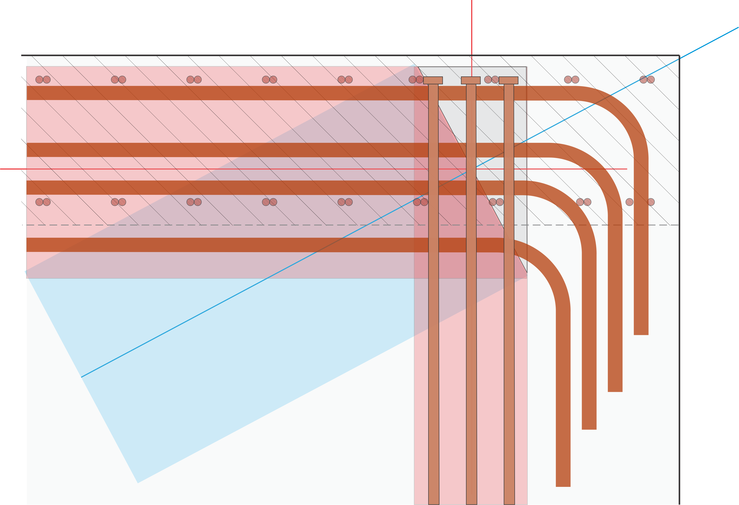
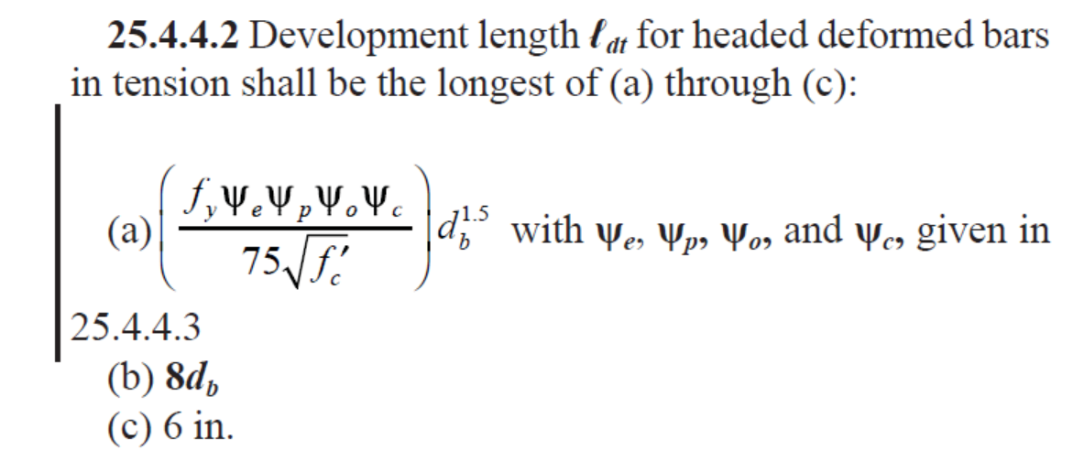
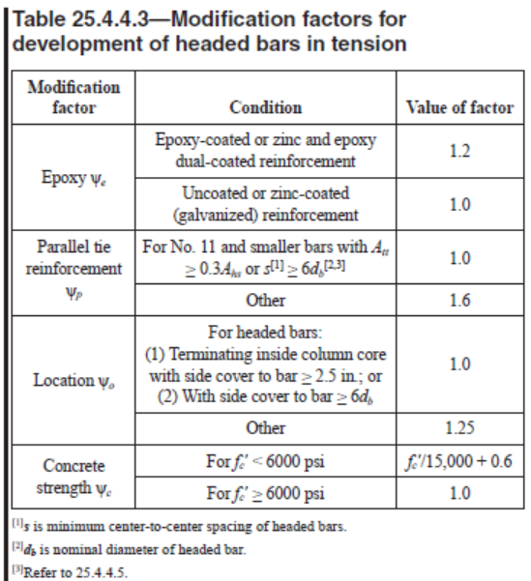
Design & Detailing of Nodal Zone i – Step 3: Bar Development
Vertical bars - tie id
8#11 bars
24.4”
6#9 bars
👌

Slide 22
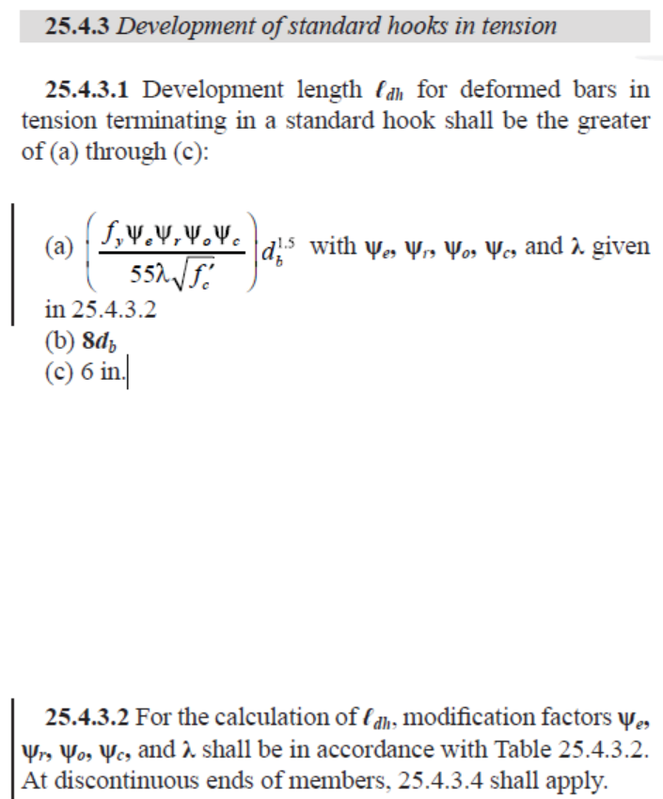
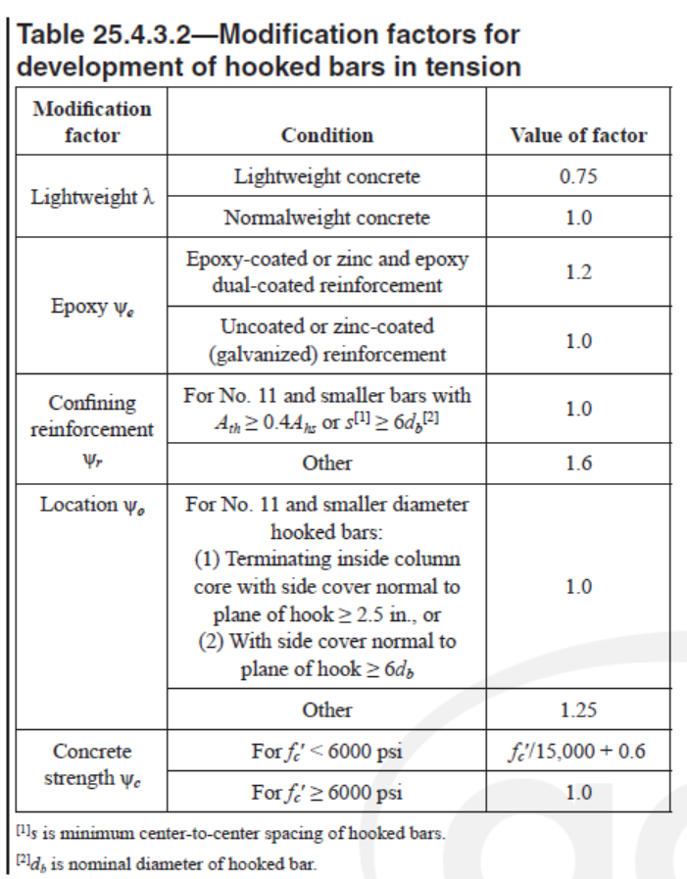
Design & Detailing of Nodal Zone i – Step 4: Bar Development
37.5”
Horizontal bars - tie ih
8#11 bars
6#9 bars

Slide 23
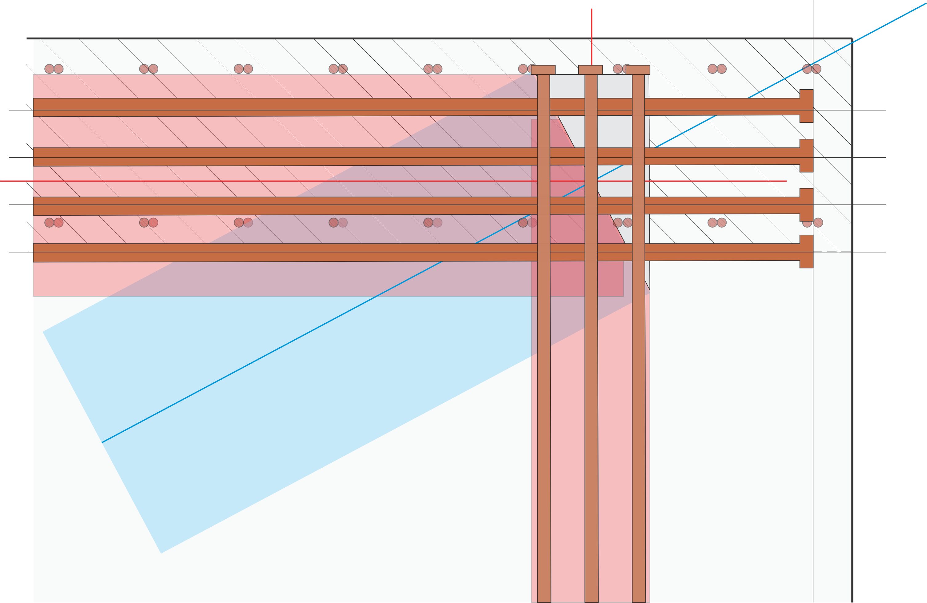
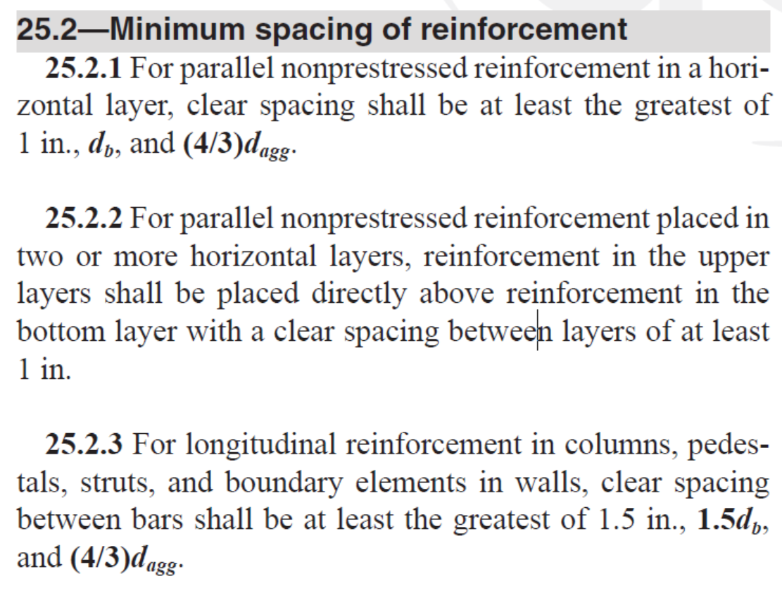
Design & Detailing of Nodal Zone i – Step 4: Bar Development
45.8”
Horizontal bars tie ih
👌

Slide 24
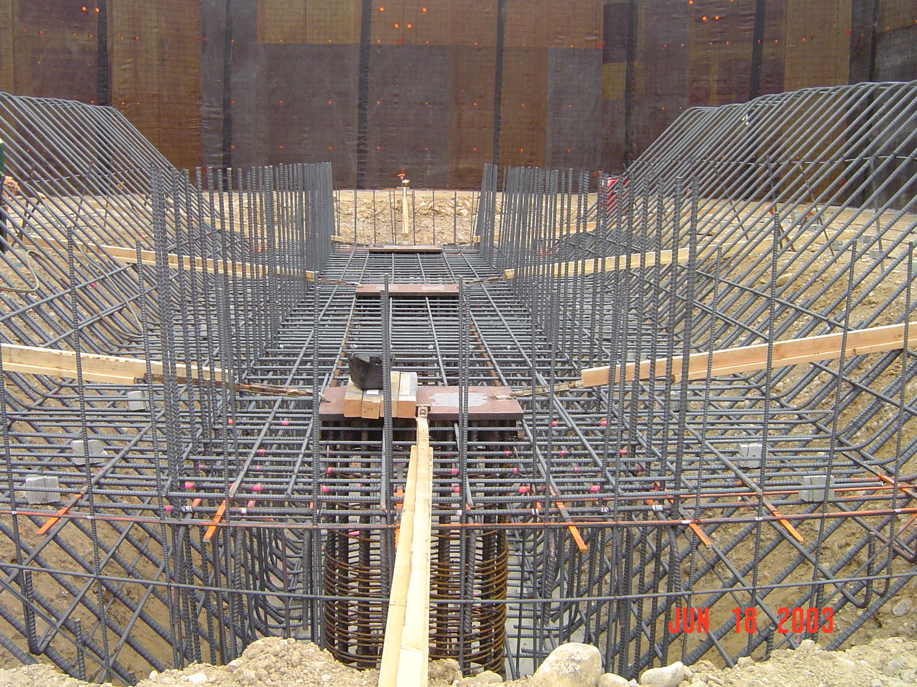
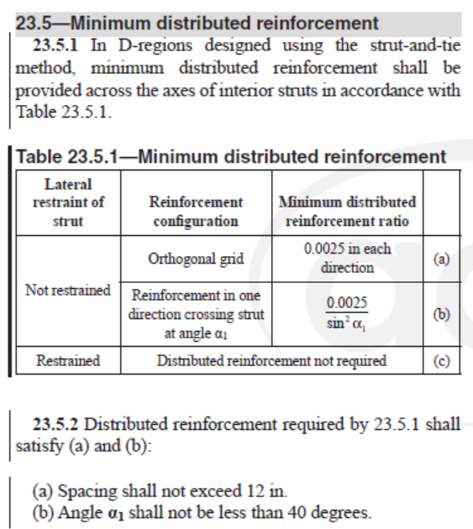
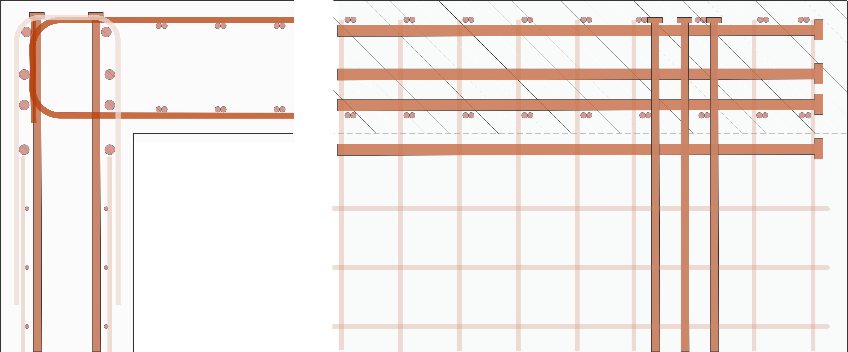
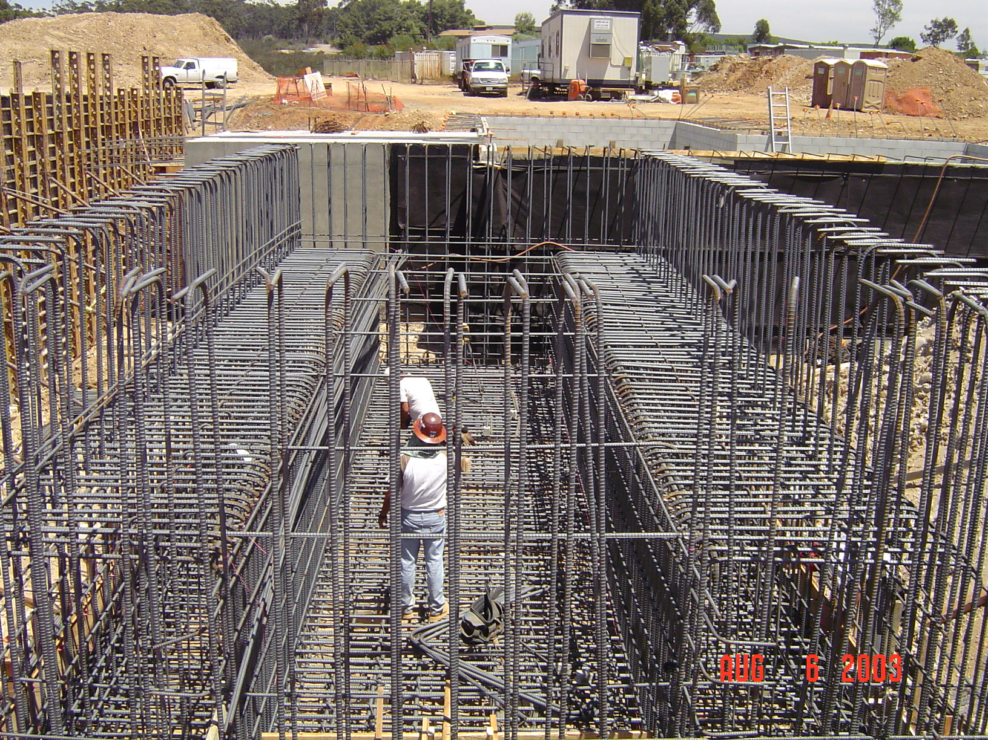
Distributed Reinforcement for Crack Control
Distributed Reinforcement Around Nodal Zone i
Cross-section Elevation
t = 18” s = 8” reinforcement in two directions on both faces,
👌

Slide 25
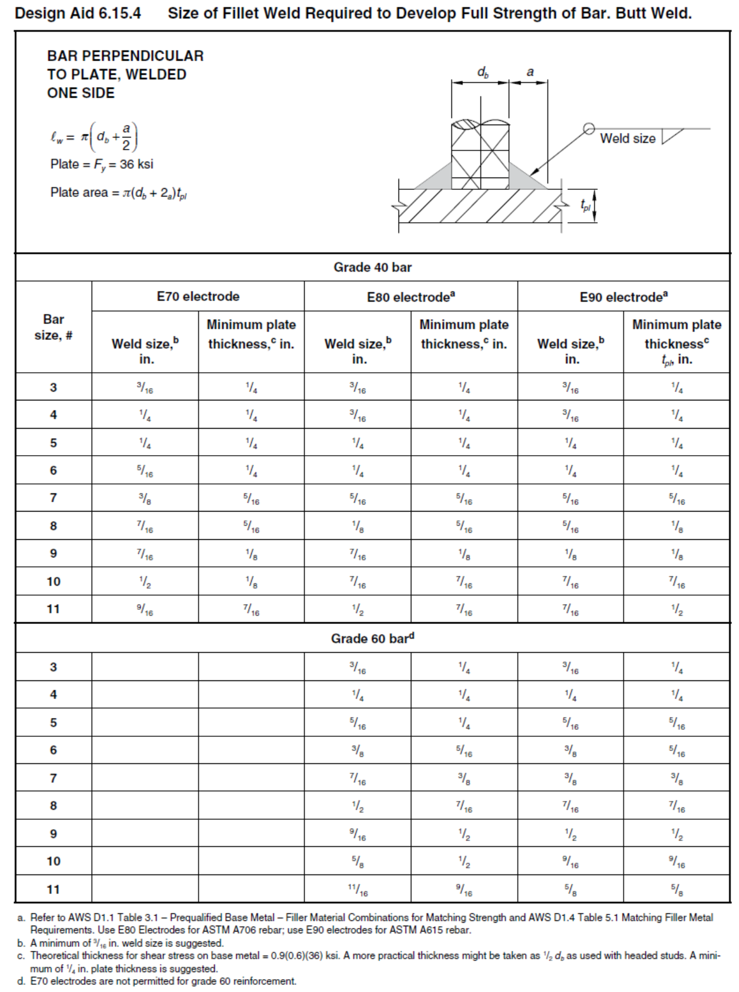
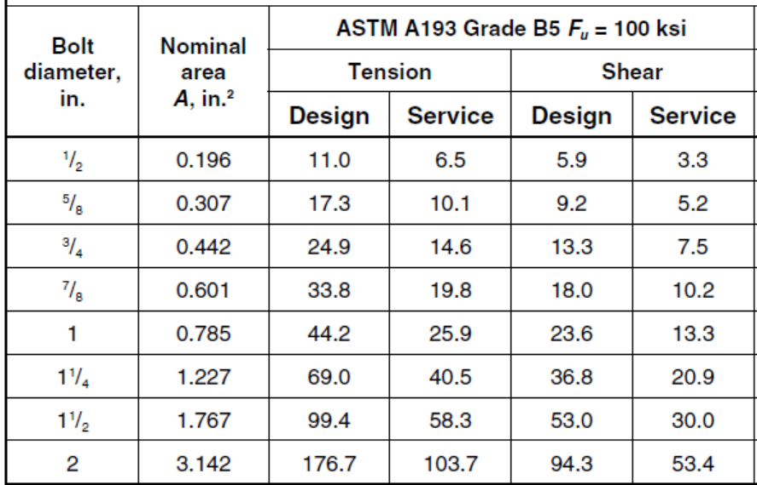
Embed Plate Design
4”
4” 5”
(typ.)

Slide 26
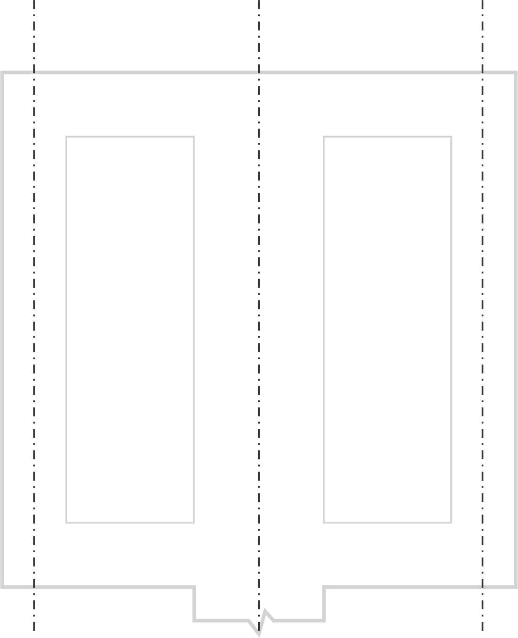
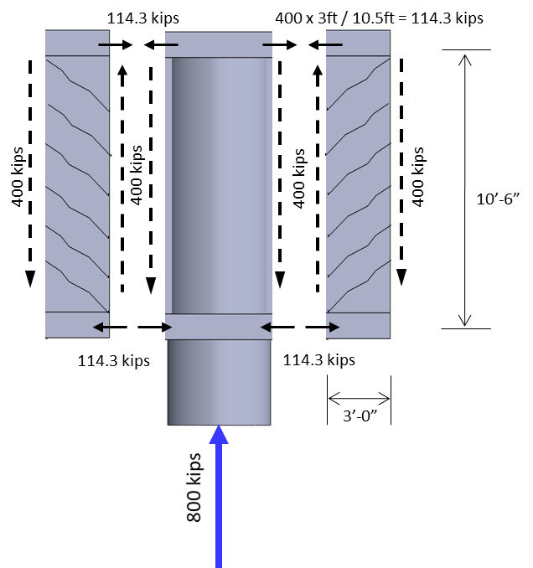
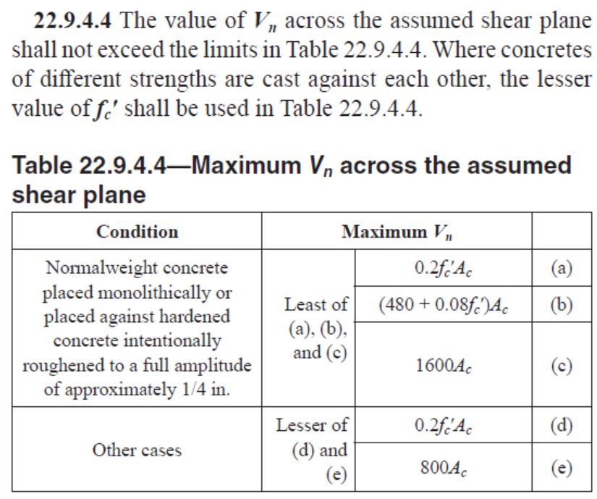
Diaphragm Design – Strut and Tie Approach
Very oblong member with a construction joint at the column face (roughened)
Note this force should be 800 kips
67.5”
400/3
400/3
👌
2 : 3
200
400/3
400/3
45” (typ.)
400/3
200
2 : 3
200
400/3
400/3
800/3
400/3
200
2 : 3
200
400/3
400
200
800
Note this force
should be 1600 kips
Wall midplane
Wall midplane
Column
centerline
Note this force should be 1600 kips
Parallel Stress Field: “Accordion Effect”
👌

Slide 27
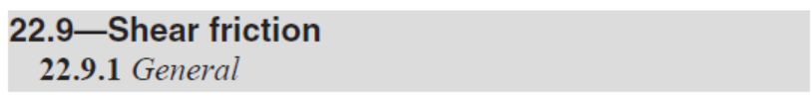
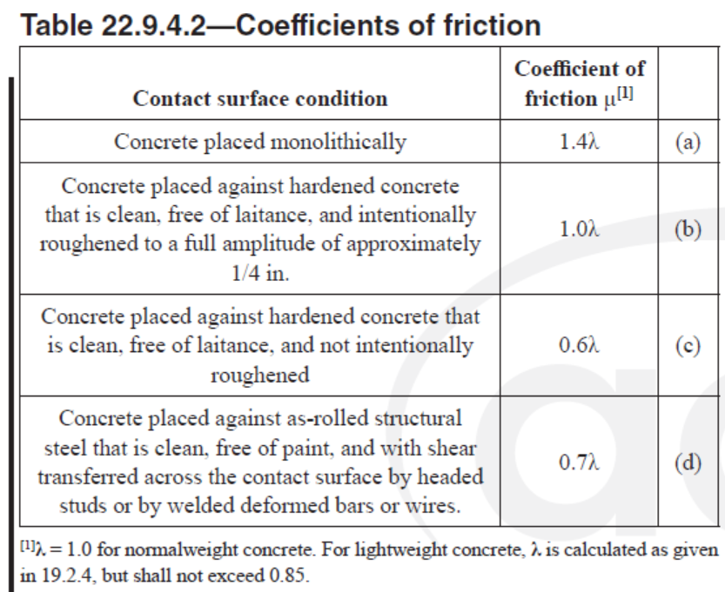
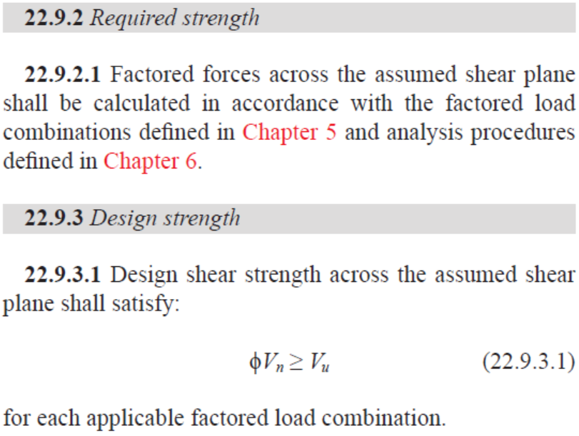


Diaphragm Design – Shear Friction Approach
👌

Slide 28


DRAWINGS
B.O.L.D. Engineers
https://cdn.xl.thumbs.canstockphoto.com/trident-shade-picture-drawing_csp44843609.jpg
9500 Gilmano Way
Suite 5201
San Diego, CA 92093
Bhat, Ojo, Lin & Dinh
Structural Engineers

Slide 29


Slide 31


Slide 32

EMBED PLATE c
(Total 1)
EMBED PLATE d
(Total 1)

